Slide 1



Sponsors

Slide 2
Introduction To Web Hacking 101
By Brandon S. Keath
Cyber Security Architect

Slide 3

Who Is This Brandon Guy Anyway?
Cyber Security Architect at Appalachia Technologies
Master’s of Cyber Security and Information Assurance from Western Governor’s University
EC-Council Certified Ethical Hack & Certified Hacking Forensics Investigator
I like to Program in Python and Hack stuff!

Slide 4
Agenda
What is a Hacker?
What makes a hacker ethical
Mindset of a hacker?
Web Hacking 101
Pre-Engagement
Intelligence Gathering
Threat Modeling/Vulnerability Analysis
Exploitation/Post-Exploitation
Reporting
Web Hacking What’s next?
Training Begins!
Websites For Learning Hacking
Capture The Flag!
Bug Bounty Hunting
Getting started in or enhancing your career in Cyber Security
Who Do Hackers Target?
Defense in Depth
Types of Cyber Security Professionals

Slide 5

What is a Hacker?
Modern Version of Hacker:
a person who uses computers to gain unauthorized access to data.
synonyms: cybercriminal, pirate, computer criminal, keylogger, keystroke logger;
Original Meaning:
Is any skilled computer expert that uses their technical knowledge to overcome a problem.

Slide 6

What is an Ethical Hacker?
A hacker who gains permission before attempting
To hack into a computer system, network, or device.

Slide 7


Mind Set of Hacker

Slide 8
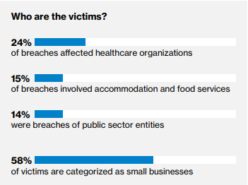
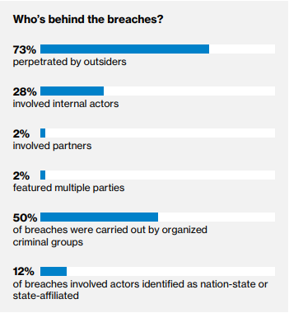
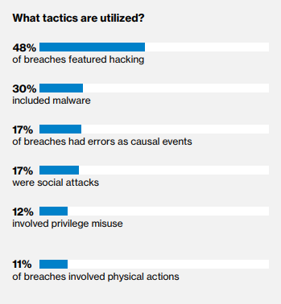
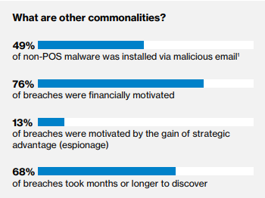
What do Hackers Target

Slide 9
Types of Cyber Security Professionals
Red
Team
Ethical Hacking
Network and Web Pen Testing
Blue
Team
Defense management
Antivirus, Encryption, Firewalls, SIEM, ETC
Purple
Team
Mix of red and blue team
Sometimes considered management or compliance related role.

Slide 10
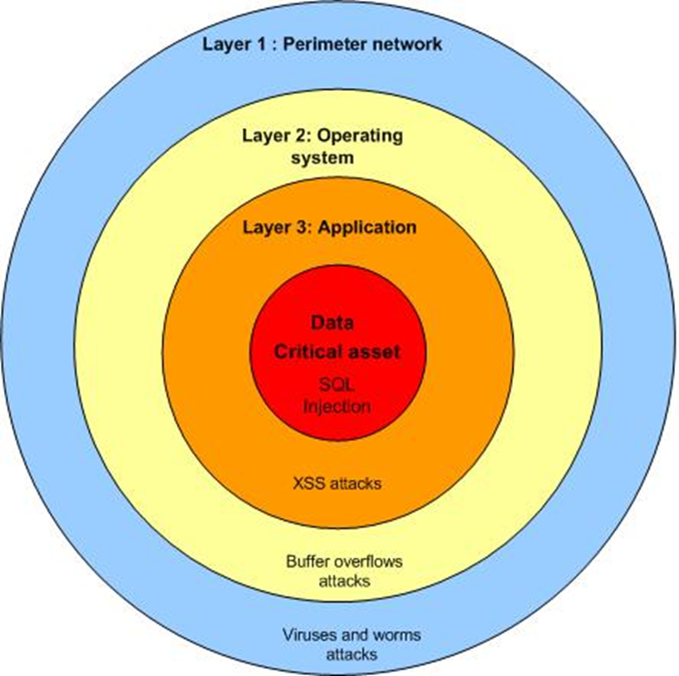

Defense In Depth

Slide 11
Hacking Methodology
Pre-engagement
Intelligence Gathering
Threat Modeling
Vulnerability Analysis
Exploitation
Post Exploitation
Reporting

Slide 12
Pre-Engagement
What is the scope of the engagement and objectives?
What are the rules for the engagement?
What is the reward for the engagement?

Slide 13


Intelligence Gathering/ Reconnaissance

Slide 14


Passive and Active Methods

Slide 15
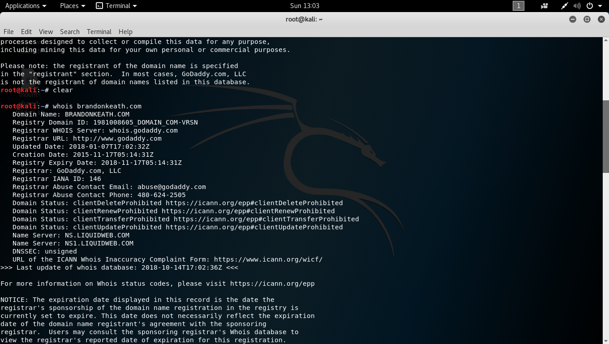
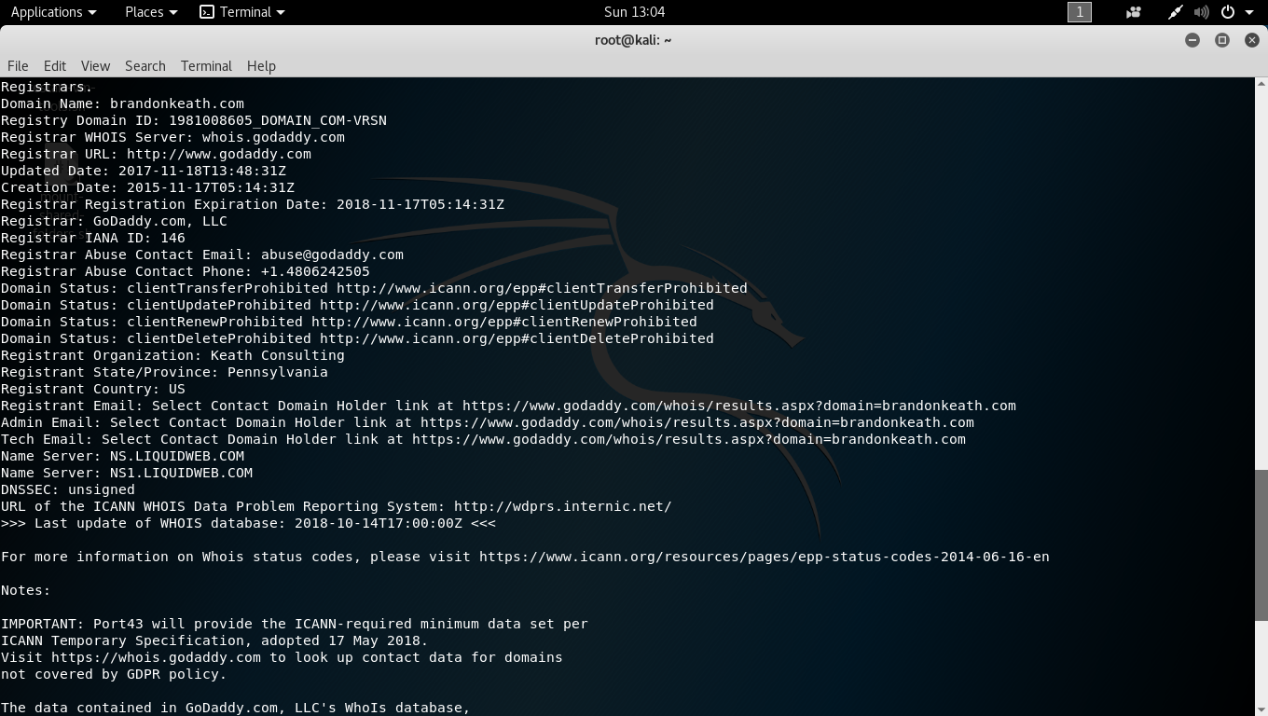
Whois Lookup

Slide 16
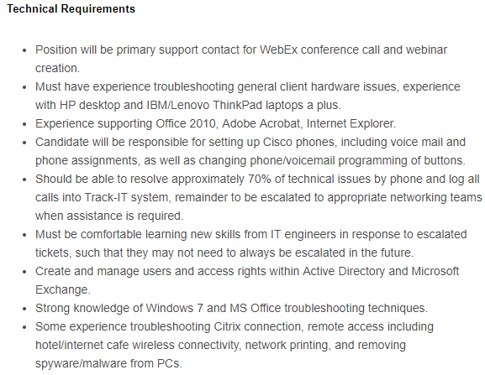
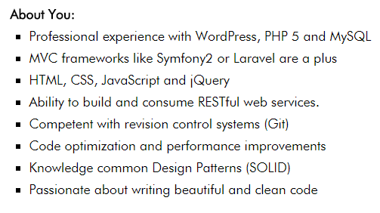
Look at Job Ad’s

Slide 17

Dumpster Diving

Slide 18
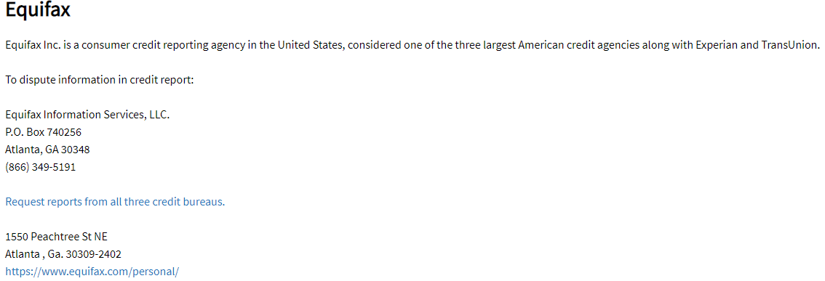
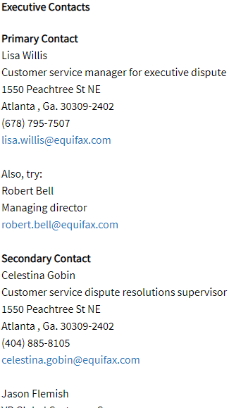
Look at Company contacts on Elliott Advocacy

Slide 19
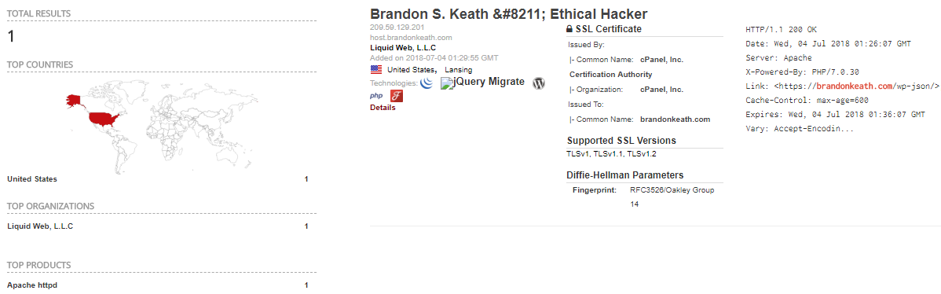
Shodan.io

Slide 20
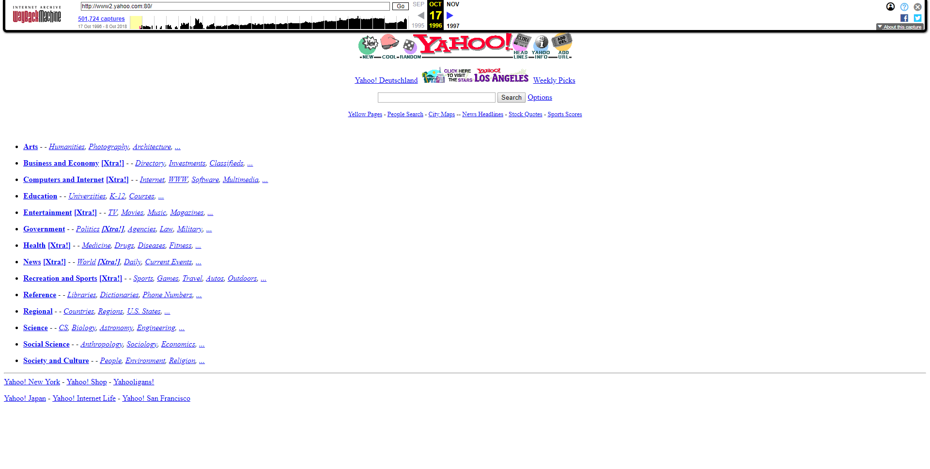
WAY-WAY-BACK-MACHINE

Slide 21
Other Reconnaissance Tools
The Harvester – Command line tool for aggregating and gathering data from subdomains, hosts, SHODAN, etc.
Recon-ng – Full featured Web Reconnaissance framework written in python including various recon, discovery, reporting, and exploitation modules.
Malteo- Interactive data mining tool that ships with Kali Linux by default, ability to analyze relationships between information and graph information.

Slide 22
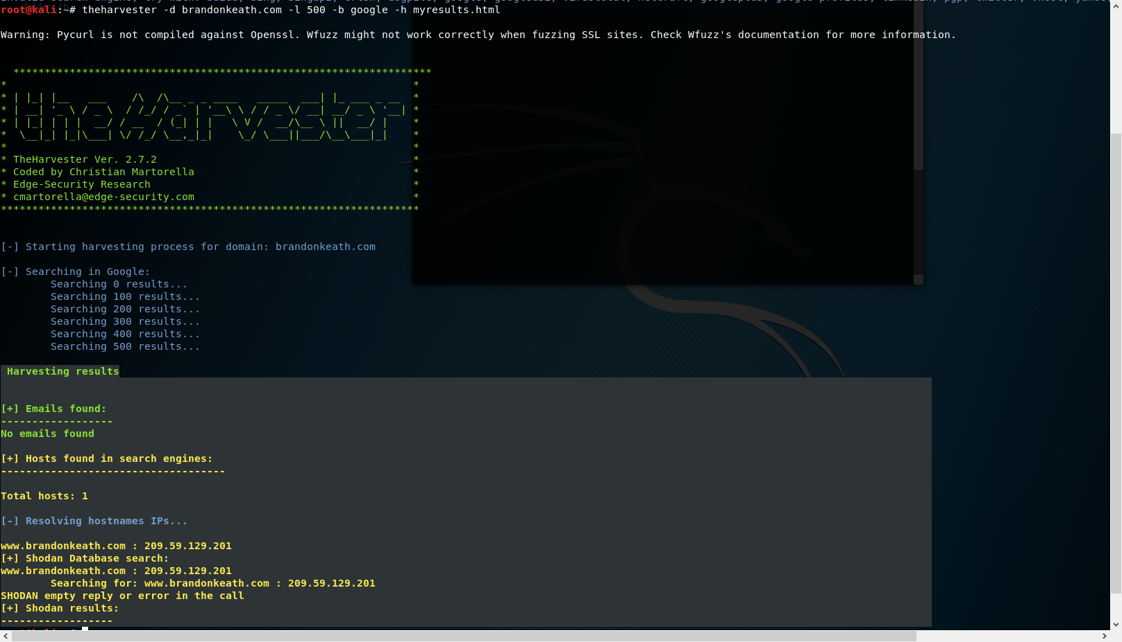

Slide 23
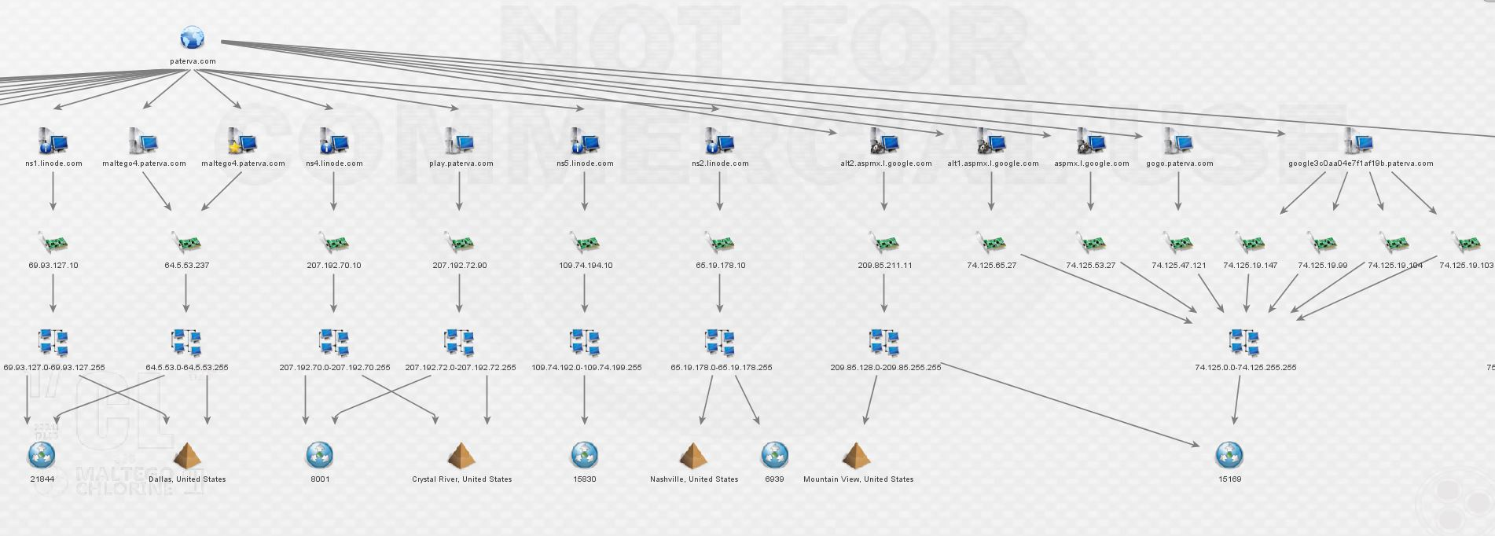
Maltego Example

Slide 24

Active Reconnaissance Scanning

Slide 25
Active Reconnaissance
Actively Visiting the Website
Scanning/Fingerprinting
Spidering
Intercepting Proxy

Slide 26

Recon Demo #1

Slide 27

Recon Demo #2

Slide 28
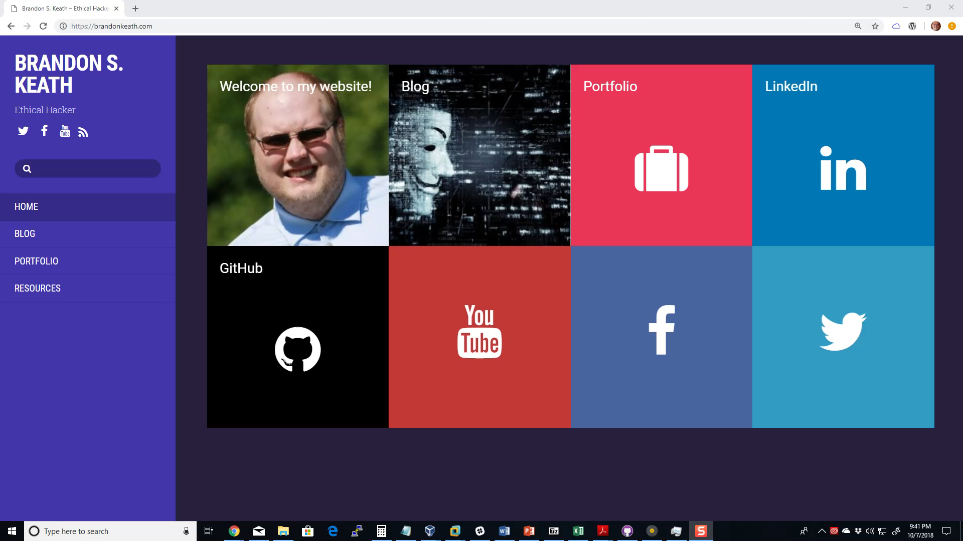
Wappalyzer

Slide 29
Nikto
Server Scanners
Looks for misconfigurations
Examines http headers
Can identify frameworks being used

Slide 30
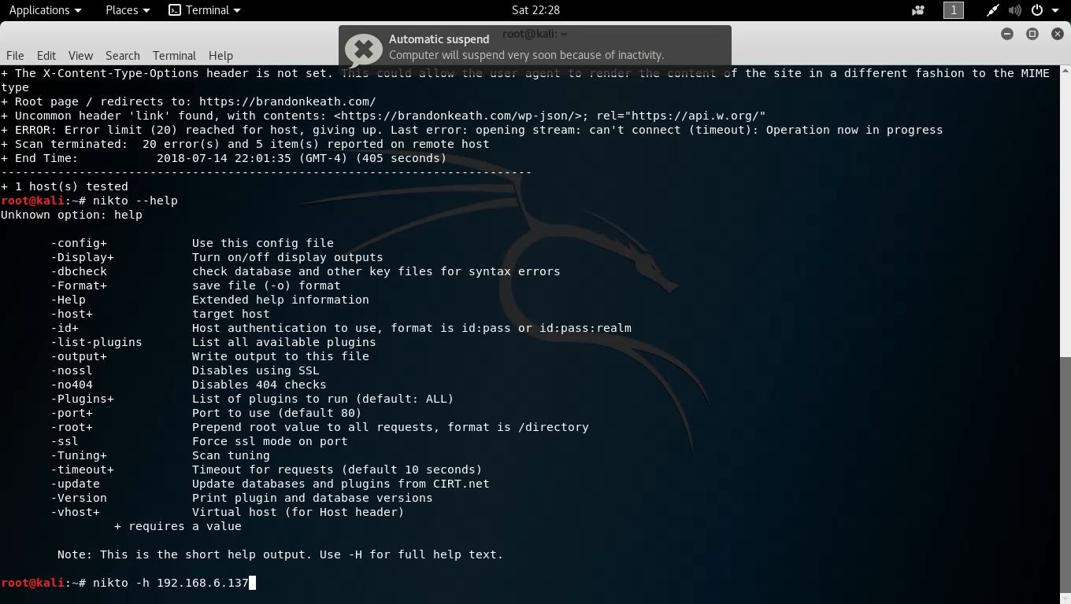
Scanning Demo Nikto

Slide 31
Skipfish
High speed web vulnerability scanner(400 requests per second)
Straight-forward and easy to use
Detects a wide range of issues including directory listings, disclosure vulnerabilities, and different types of SQL and XML injections

Slide 32
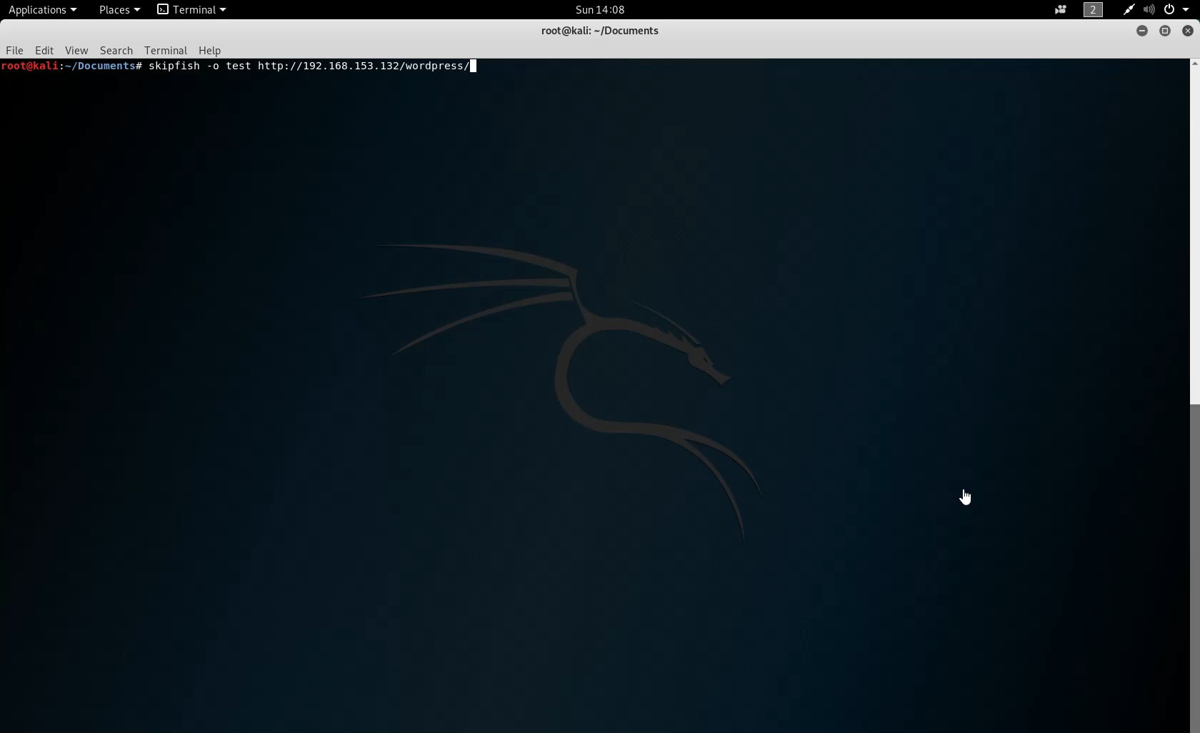

Slide 33
Arachni
Web Application Exploitation Framework
Automate and Schedule Scans
High success rate of detection
100% free and open source!

Slide 34
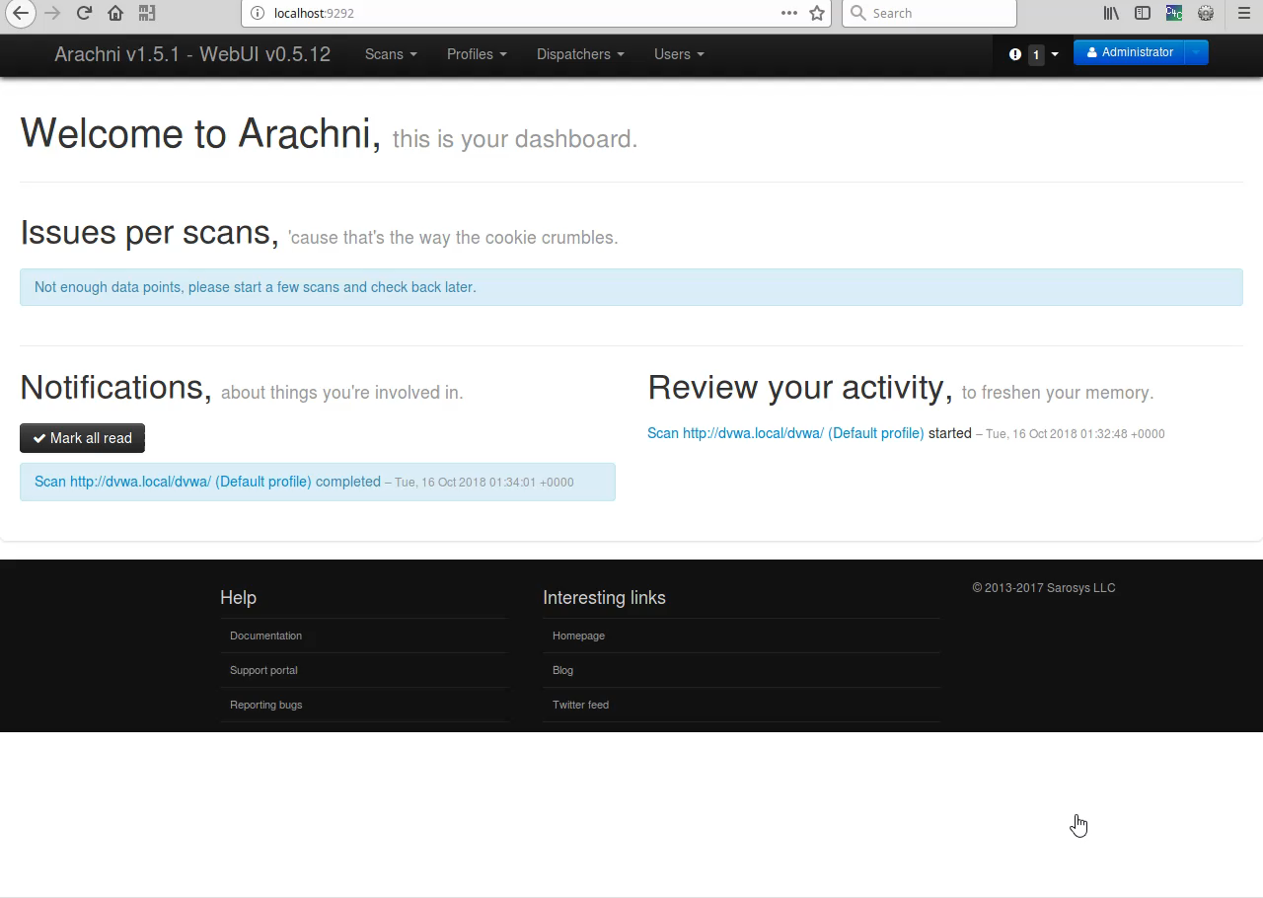
Arachni Demo

Slide 35
OWASP ZAP
OWASP ZAP is an easy to use integrated pen testing tool for finding vulnerabilities in web applications.
Zap provides automated tools and is an intercepting proxy that can be used for finding vulnerabilities.
Zap is a great tool for most web application penetration testing needs however Burp Suite Pro is considered more powerful

Slide 36
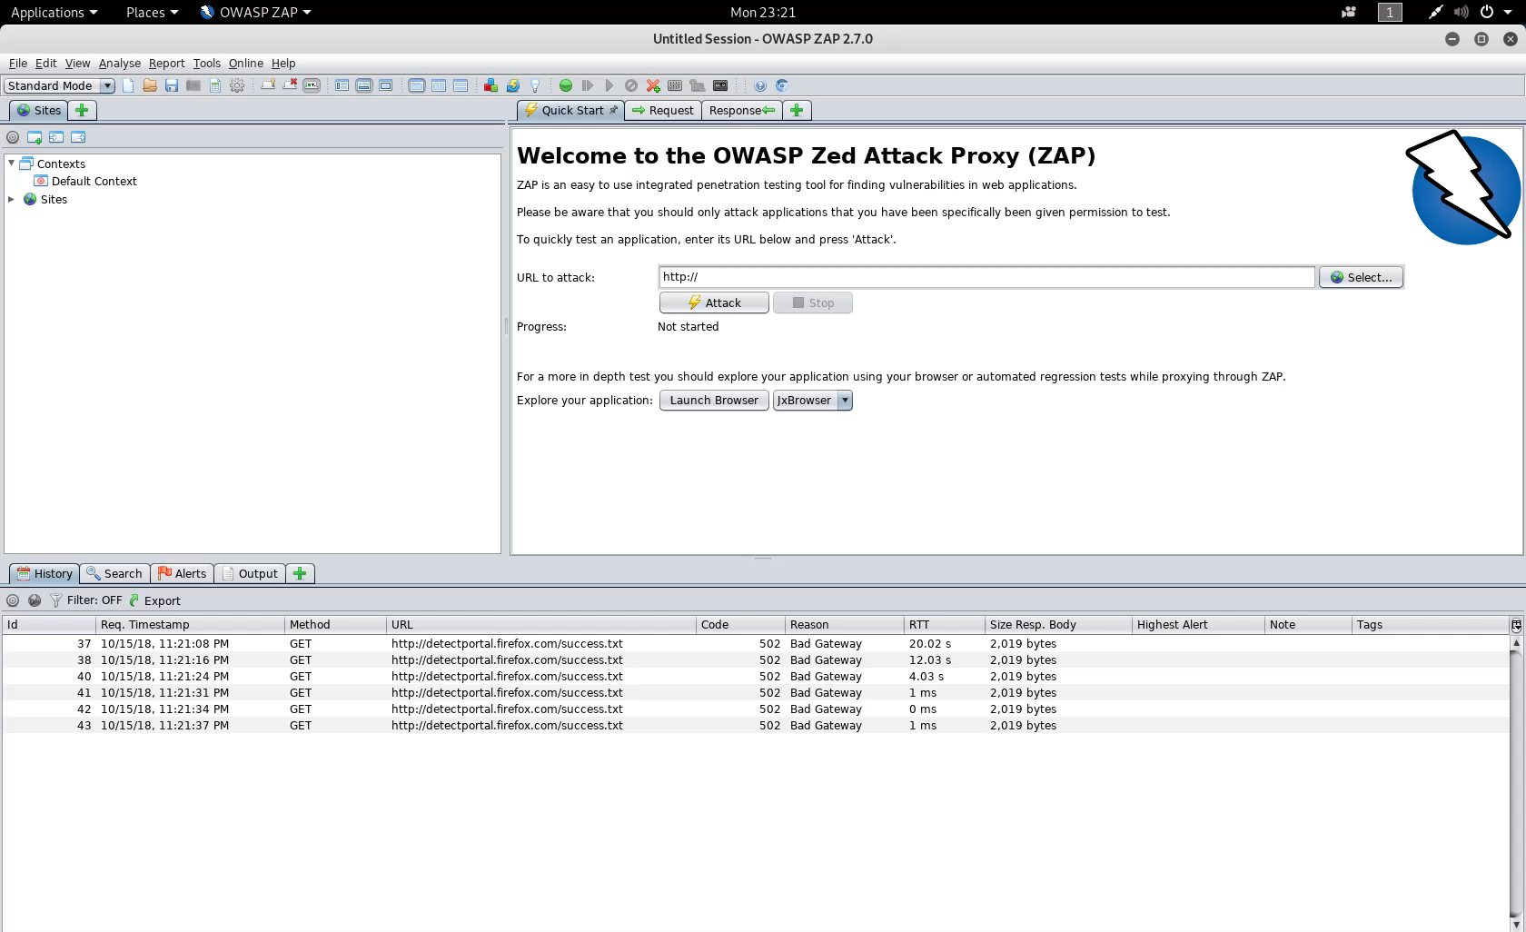
OWASP ZAP Demo 1

Slide 37
Burp Suite
Burp Suite is a commercial tool that includes the following:
Automated crawl and scan of 100 vulnerabilities
Intercept browser traffic as a man in the middle proxy
Automate custom attacks using Burp Intruder
Extensible with Python and Java Programming plugins
Burp is considered the standard for web penetration testing and costs $400 for a commercial license.

Slide 38
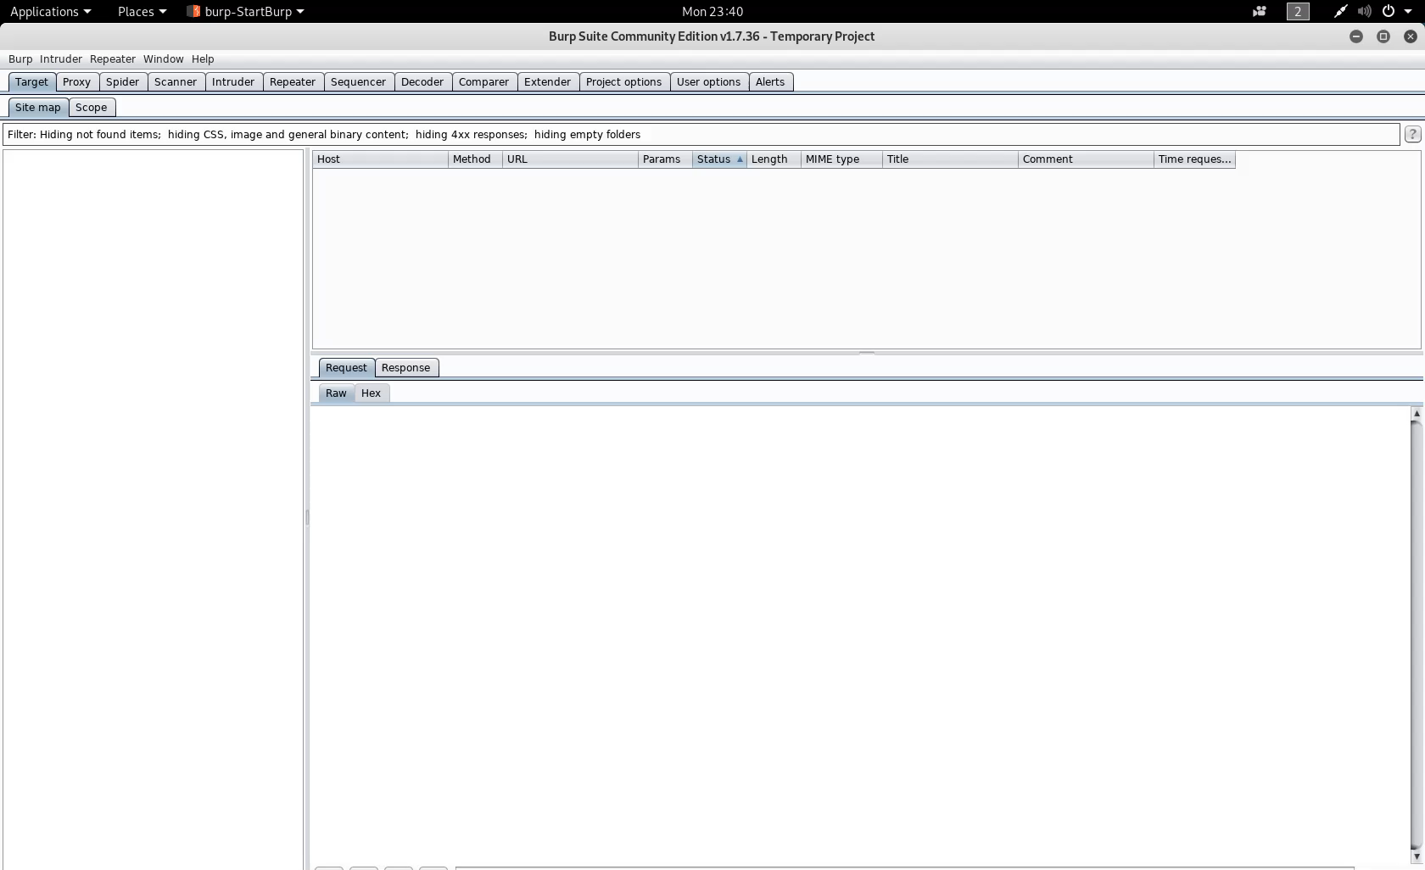
Burp Suite Demo 1

Slide 39
Roll your own in Python & Automate!
Scapy – Python library that allows you to craft and forge your own packets, similar to NMAP.
Requests – A python library that allows you to send all kinds of http requests.
Scrapy- Python library that allows you to run, automate, and build your own web-spiders in Python just like ZAP & Burp!
MITMProxy- Command line proxy that can be used like Zap & Burp with a python API for automating repetitive tasks.

Slide 40

Review What is Reconnaissance

Slide 41
Threat Modeling
What did I find?
How valuable is what I found?
What is the threat to the business or Organization?
What threats does this organization face from cybercriminals?

Slide 42
Where do I start and what really is a secure web application?
OWASP provides a free Web Application security testing framework providing a foundation for testing: OWASP Testing Guide 4.0
OWASP Provides a detailed definition of what a “secure” web application is in their Application Security Verification Standard (ASVSP)
BWAPP provides an insecure web application that you can practice web hacking on.

Slide 43
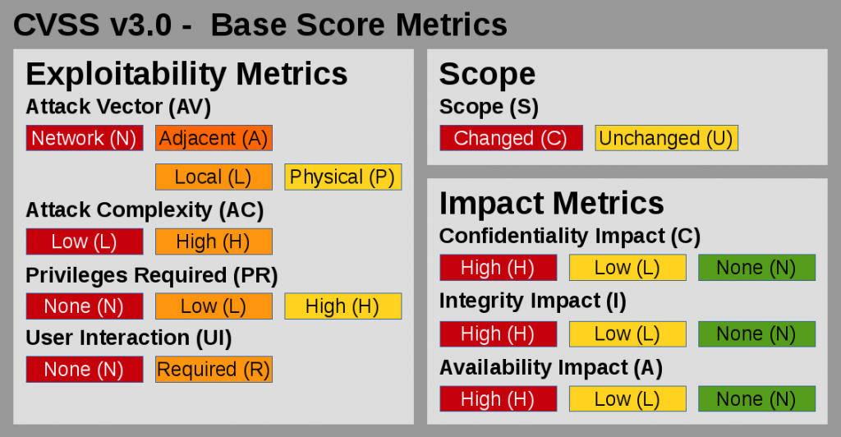
Vulnerability Analysis
OWASP Top 10
OWASP Testing Framework
Common Vulnerability Scoring System

Slide 44
Vulnerability Analysis using OWASP Top 10
OWASP releases a Top 10 that details information OWASP Top 10
OWASP TOP 10
A1 Injection | A2 Broken Authentication
A3 Sensitive Data Exposure | A4 XML External Entities
A5 Broken Access Control | A6 Security Misconfiguration
A7 Cross Site Scripting | A8 Insecure Deserialization
A9 Using Known Vulnerable Components | A10 Insufficient Logging & Monitoring

Slide 45
Exploitation & Post Exploitation
Actively Exploiting the vulnerabilities(need permission first)
Verifying if vulnerabilities are accurate
Pivoting to other systems to test additional vulnerabilities
During Post-Exploitation, cleaning up any potential left over scripts.

Slide 46
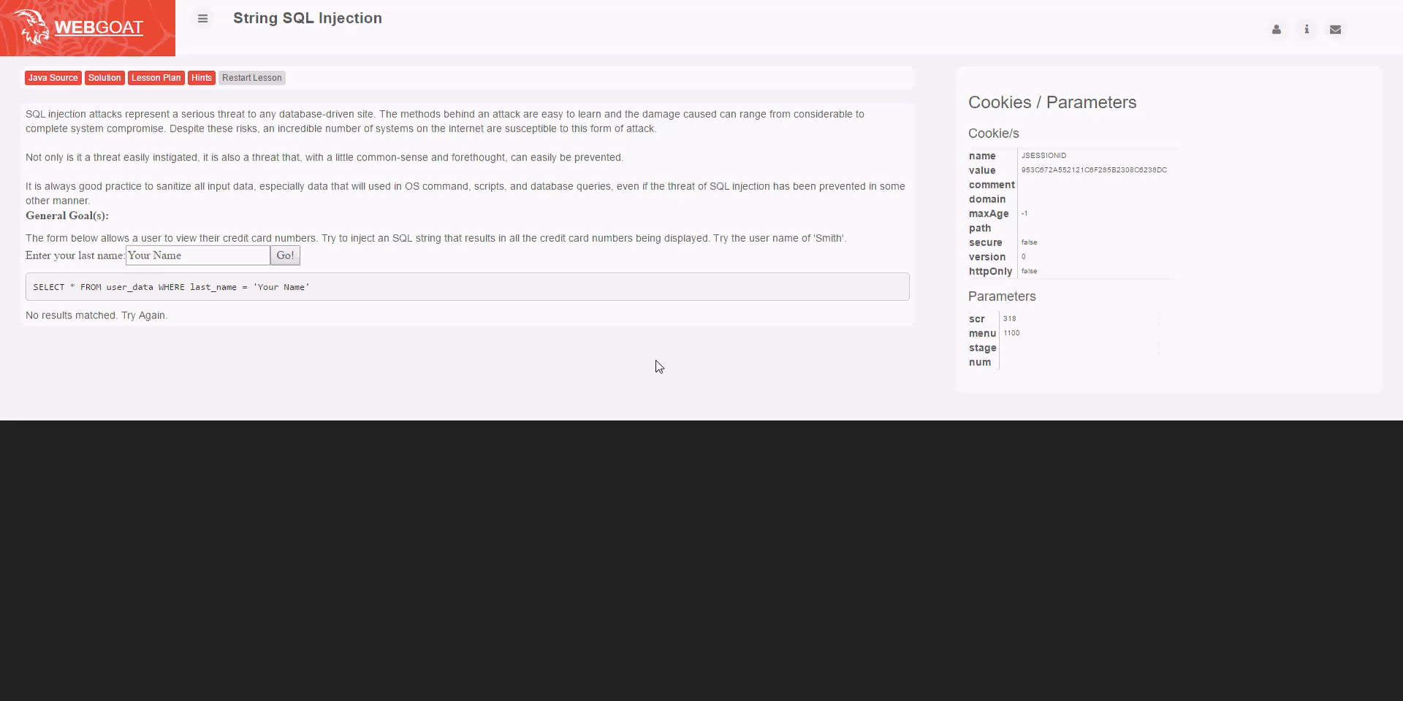
Exploitation SQL Injection

Slide 47
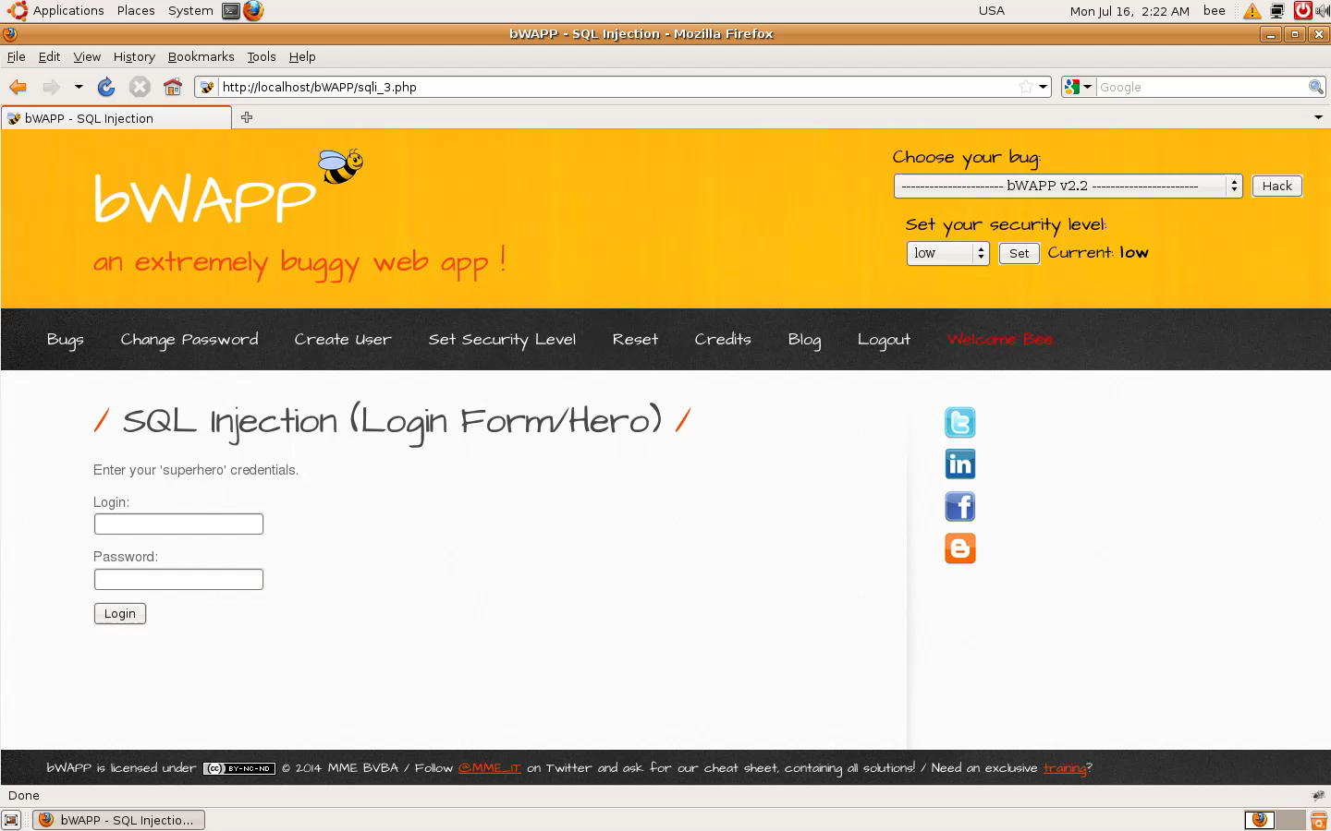
SQL Injection 2

Slide 48

Reporting
This Photo by Unknown Author is licensed under CC BY

Slide 49
Reporting Tips
Include concise clear information
Include an executive summary of findings
For bug bounties include a short video showing vulnerability
Give an explanation of the impact of the vulnerability to the organization!

Slide 50
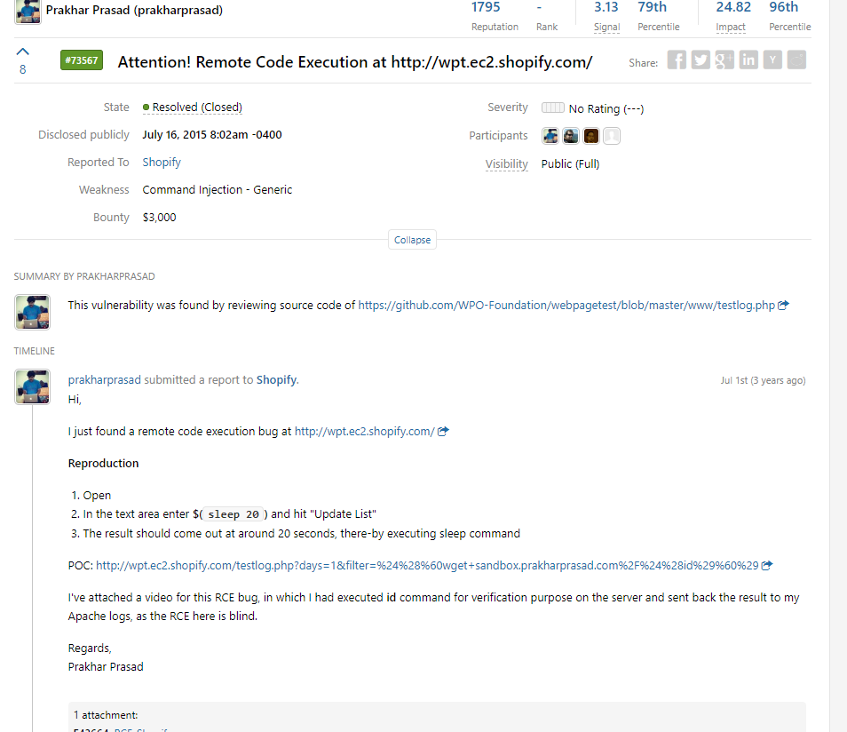
Example Reports
Reports can be shorter or longer depending on the engagement and the size of the engagement.
Penetration tests cost an average of $33,000 per engagement.
Bug Bounties focus on one particular flaw or error and payouts range from $50-$120,000 for one flaw.

Slide 51

This Photo by Unknown Author is licensed under CC BY-SA-NC

Slide 52
Let the Training Begin!
OWASP Broken Web Apps
Virtual Box for running various machines
Web Security Dojo
Download Kali Linux
HackSplaining is a great resource for learning about web exploits

Slide 53
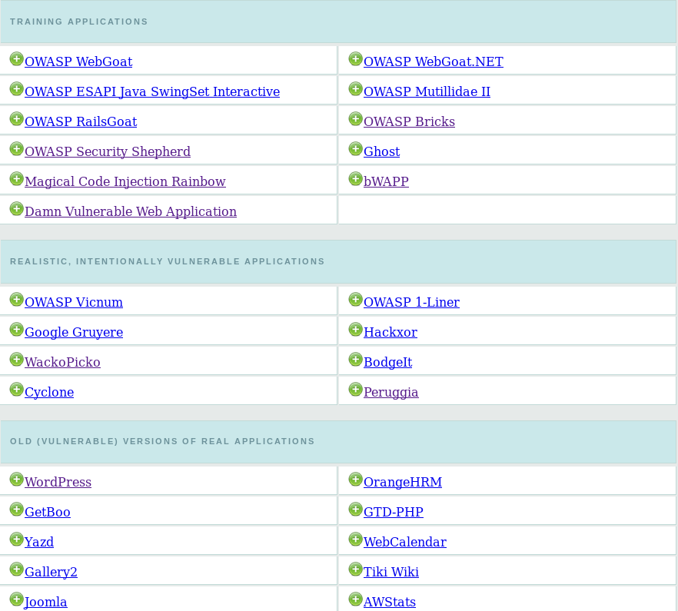
OWASP Broken Web Apps Training

Slide 54
Websites for Learning Hacking
https://www.offensive-security.com/metasploit-unleashed/
https://null-byte.wonderhowto.com/
https://cybrary.it

Slide 55
Bug Bounty Hunting?
Application Security Testing in Production!
Bug bounty hunters earn between $10,000-$500,000/year as hunters
www.hackerone.com
www.bugcrowd.com
https://www.hacker101.com/

Slide 56
Capture The Flag!
HackTheBox
CTF365
OverTheWire
Vulnhub
Pwnable.kr
HackThisSite
W3challs
HACK.ME
RingZer0 Team Online CTF
Try2Hack
HackThis!!
Enigma Group
RootMe

Slide 57
Resources for Getting Started in Cyber Security
Meetups and Events like this one!
https://Cybrary.IT
https://ElearnSecurity.com
Learn Python from Microsoft:
https://mva.microsoft.com/en-us/training-courses/introduction-to-programming-with-python-8360

Slide 58

Open Questions and Answers
Visit my terrible blog at www.brandonkeath.com for security updates.
Check out http://pahackers.com to stay up to date for new ethical hacking meet ups and events in the local area.
Sign up for the free Pen Testing Student
Class offered by ElearnSecurity by singing up for
The Ethical Hacker Network
https://www.ethicalhacker.net/register/

